Slide 1
Exploratory Data Analysis on Netflix Data.

Slide 2
Content
Introduction
Dataset
Exploratory Data Analysis
String Column Analysis

Slide 3
Introduction
Netflix, is one of the most popular OTT platform around the globe. It’s an American subscription streaming service and production company. Launched on August 29, 1997, it offers a library of films and television series through distribution deals as well as own production Netflix Originals.
The goal of this project is to analysis the Netflix TV Shows and Movies. I have explore the Netflix dataset through visualizations and graphs using python libraries, pandas and plotly.

Slide 4
Dataset and Libraries
I used Netflix Movies and TV Shows dataset from Kaggle. It contains 8807 unique TV Shows and Movies.
Data link:- https://www.kaggle.com/datasets/shivamb/netflix-shows
Used Libraries:- 1) Pandas - for data manipulation and analysis.
2) Plotly - to display data and make it interactive.

Slide 5
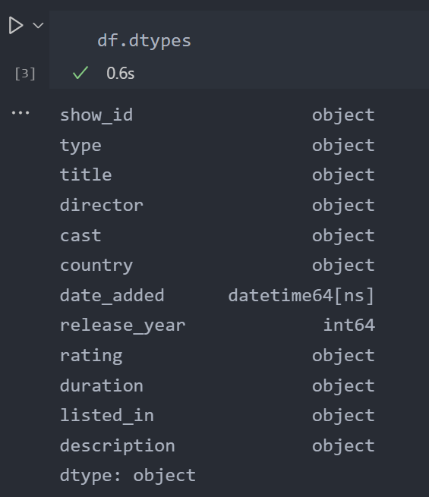
Exploratory Data Analysis
Changed date_added datatype to date format from object.

Slide 6
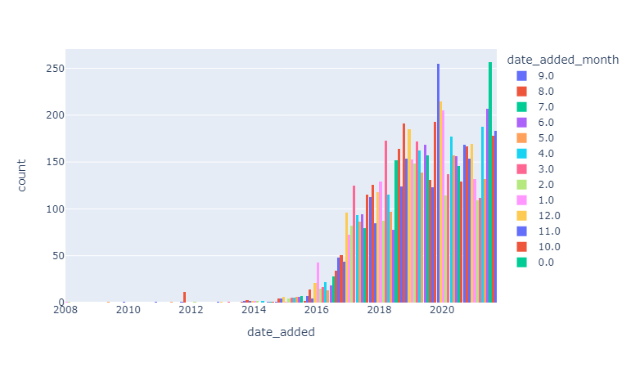
Exploratory Data Analysis
2 new columns are created date_added_month and date_added_day, which shows the month and day wise count of each year.

Slide 7
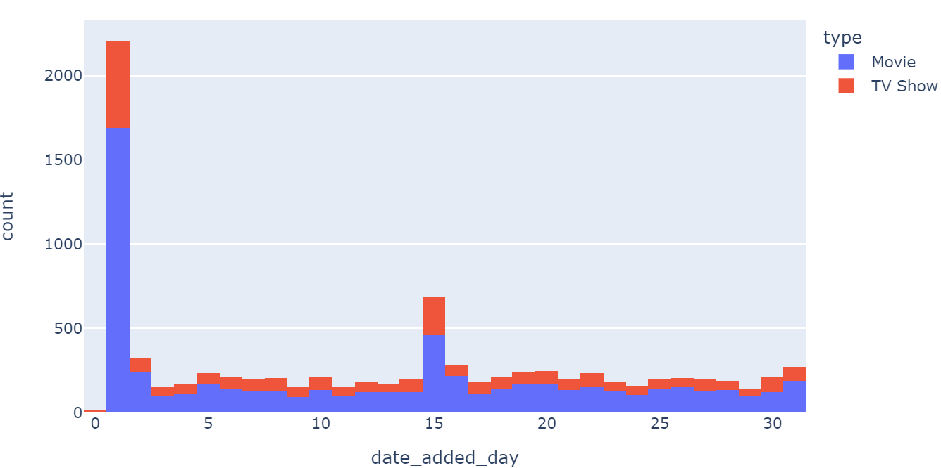
Exploratory Data Analysis

Slide 8
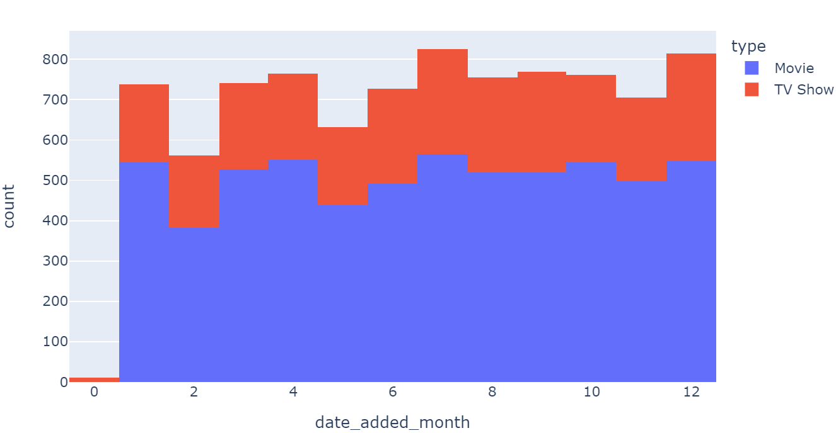
Exploratory Data Analysis

Slide 9
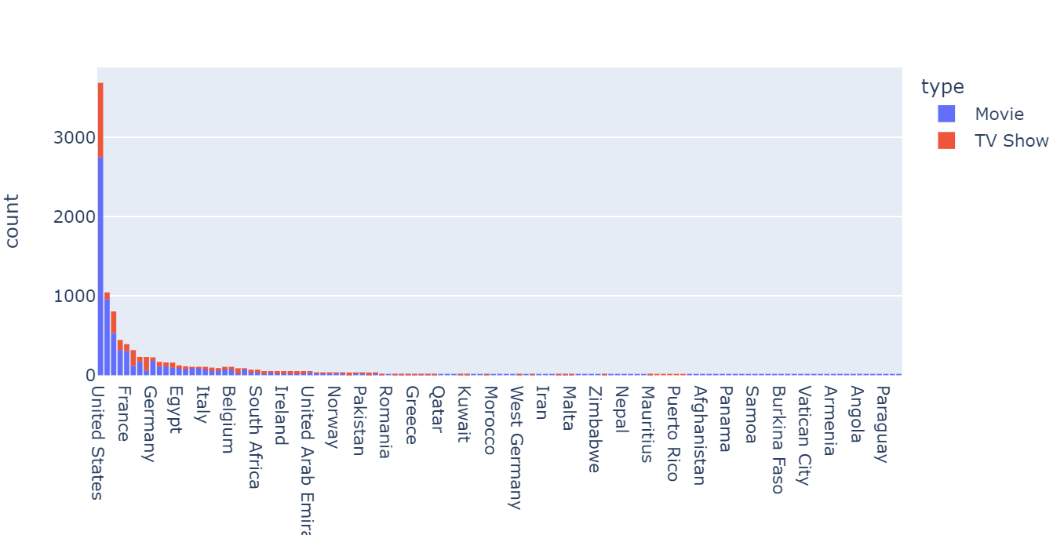
String Column Analysis
For String column analysis, I have created new dataframe; country_count with 3 columns type, title and country.

Slide 10
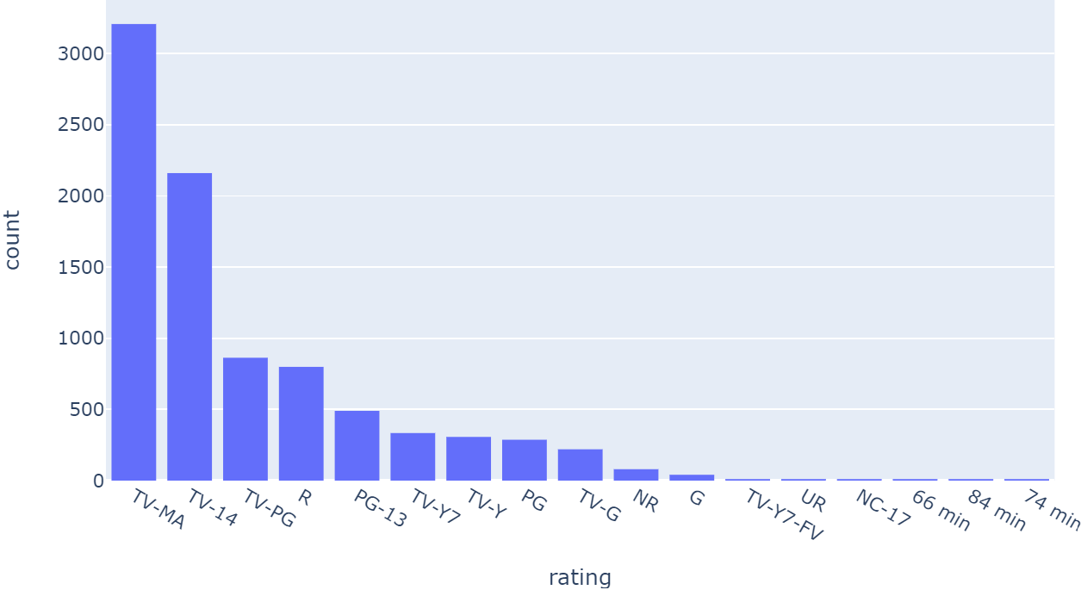
String Column Analysis

Slide 11
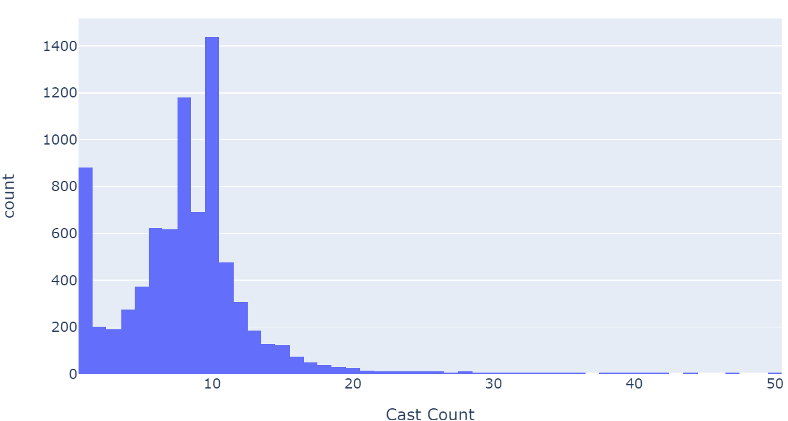
String Column Analysis

